Slide 1
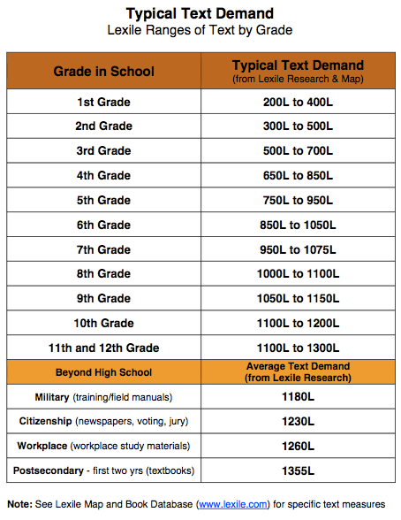
Reading Lexile Levels
All readings are not created equally.
Table retrieved from azed.gov

Slide 2
What is a Lexile Level?
A Lexile Level is a term used to describe the reading difficulty of a text and a reader’s ability to comprehend a text.
This means:
a reader has an individual Lexile Level.
every text has its own Lexile Level.
When you read a text that matches your reading level, you understand it better than reading the same information written at a more complicated Lexile Level.

Slide 3
What do we know about Lexile Levels and College Reading?
According to the Common Core State Standards in English and Language Arts, we know that the college students are:
expected to read more complex texts with less support than high school students.
entering college unprepared for the level of text complexity.
According to ACT, only 43% of high school graduates met the reading benchmarks of college readiness in 2013. This was nearly 10% below the national average.

Slide 4
What are the reading demands of the post-secondary world according to Lexile Measures?
Median Text Measures (Williamson, 2004):
11th/12th grade (LA/SS textbooks): (1090L)
GED Test Materials: (1060L)
SAT/ACT Test Materials: (1180L)
Military (training/field manuals): (1180L)
Citizenship (newspapers, voting, jury): (1230L)
Workplace (Daggett study materials): (1260L)
Postsecondary - first two yrs. (textbooks): (1355L)
University (1395L)
Community College (1295L)

Slide 5
What are the reading demands of the post-secondary world according to Lexile Measures?
Newspapers (Daggett, 2003):
USA Today (1200L)
Associated Press (1310L)
Chicago Tribune (1310L)
Wall Street Journal (1320L)
Washington Post (1350L)
NY Times (1380L)
Reuters (1440L)

Slide 6
What are the reading demands of the post-secondary world according to Lexile Measures?
Personal Reading - Citizen Reading Materials (Williamson, 2004):
CD-DVD Player Instructions (1080L)
GM Protection Plan (1150L)
Microsoft Windows User Manual (1150L)
Installing Your Child Safety Seat (1170L)
Federal Tax Form W-4 (1260L)
Application for Student Loan (1270L)
Medical Insurance Benefit Package (1280L)
Aetna Health Care Discount Form (1360L)

Slide 7
What are the reading demands of the post-secondary world according to Lexile Measures?
Entry-level Occupational Reading Materials - Career Clusters (Daggett, 2003):
Agriculture/Natural resources (1270-1510)
Architecture/Construction (1210-1340L)
Arts/AV Technology/Communications (1100-1190L)
Business and Administration (1210 – 1310L)
Education and Training (1320-1370L)
Health Science (1260-1300L)
Hospitality and Tourism (1230-1260L)
Human Services (1050-1200L)
Law and Public Safety (1420-1740L)
Manufacturing (1200-1310L)
Retail/Wholesale Sales and Service (1180-1270L)
Scientific Research/Engineering (1190-1250L)
Transportation, Distribution and Logistics (1170-1350L)

Slide 8
What happens if I read a text that is at a higher level than my Lexile Level?
When you read a text that is at your level, you can expect to comprehend approximately 75% of the information (which is why it’s important to annotate questions to ask your instructor and attend class for clarification of concepts).
When you read a text that is higher than your level, your comprehension decreases.
- A text that is 250L higher than your reading level can result in comprehending only 50% of the material. This low comprehension can lead to failing test scores or low job performance.

Slide 9
What is my Reading Lexile Level?
While there are programs that you can pay for to assess your Lexile Level, you can also determine your own reading level by knowing two things:
The Lexile Level of the text you are reading.
Your comprehension of the text you have read.
In this class, we will share with you the reading Lexile Levels of the texts you are reading and also share with you how you can build your ability to read at higher levels by building your background knowledge.

Slide 10
References
Common Core State Standards for English Language Arts & Literacy
in History/social Studies, Science, and Technical Subjects. Albany,
NY: New York State Education Dept., 2011. Common Core
State Standards Initiatives: English Language Arts Standards.
Common Core State Standards Initiative, 2015. Web. 27
May 2015.
Massengill, Gina, M.Ed. "College and Career Readiness:
Through the Lens of Lexiles." College and Career
Readiness: Through the Lens of Lexiles. The TTAC Telegram,
n.d. Web. 27 May 2015.
"The Reality of College Readiness 2013: Arizona.” www.act.org.
ACT, Inc., 2013. Web. 27 May 2015.

